Slide 1
CNLAB PROTOCOL

Slide 2
Overview
Development environment:
  Sensor nodes: Zoulertia RE-Mote B
  Scheduling Server: Raspberry Pi 3 Model B
  OS: Contiki-NG
Precondition:
  Each sensor nodes has an unique ID.
  The coordinator will be started after another sensor nodes

Slide 3
Overview
INITIALIZE STATE
MEASURE LINK QUALITY STATE
MAKE ROUTING STATE
COLLECT NODE INFORMATION STATE
MAKE SCHEDULE STATE
DATA TRANSMISSION STATE
Fig. 1: Protocol operation state

Slide 4
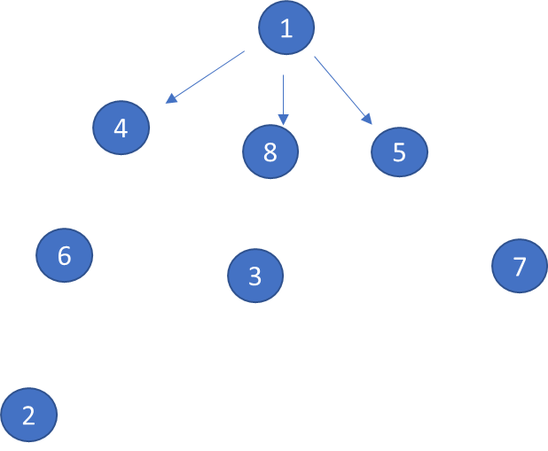
Initialize state
At initialize state, each node assigned in orchestra slotframe.
Implemented in /contiki-ng/os/services/orchestra/cnlab-orchestra-rule-eb-period.c
Node ID
Timeslot
Tx: Transmit
Rx: Receive
Timeslot 0 -> 7: Assigned for Node 1 -> 8 respectively
 | 0 | 1 | 2 | 3 | 4 | 5 | 6 | 7
1 | Tx | Rx | Rx | Rx | Rx | Rx | Rx | Rx
2 | Rx | Tx | Rx | Rx | Rx | Rx | Rx | Rx
3 | Rx | Rx | Tx | Rx | Rx | Rx | Rx | Rx
4 | Rx | Rx | Rx | Tx | Rx | Rx | Rx | Rx
5 | Rx | Rx | Rx | Rx | Tx | Rx | Rx | Rx
6 | Rx | Rx | Rx | Rx | Rx | Tx | Rx | Rx
7 | Rx | Rx | Rx | Rx | Rx | Rx | Tx | Rx
8 | Rx | Rx | Rx | Rx | Rx | Rx | Rx | Tx
Table 1: Example of Orchestra slotframe with 8 nodes.

Slide 5
Initialize state
Coordinator broadcast EB packet at timeslot 0.
All the sensor node in scan mode.
1
4
8
5
6
7
3
2
Fig. 2: Example network in initialize state.

Slide 6
Initialize state
If the node receive EB packet, it will join the network and broadcast EB packet in it assigned timeslot.(Node 4 (timeslot 3))
After sensor node join to the network, it will broadcast its EB packet.
1
4
8
5
6
7
3
2
Fig. 2: Example network in initialize state.

Slide 7
Initialize state
We predefine MAX_DEPTH_LEVEL(16) for initialize state to wait for all node receive EB and join the network.
An event timer will be triggerred after this time.
Implemented in /contiki-ng/os/net/mac/tsch/cnlab-tsch-measure-link-quality.c
PROCESS(cnlab_measure_link_process, "measure link process");
1
4
8
5
6
7
3
2
Fig. 2: Example network in initialize state.

Slide 8
Initialize state
➔ After that it change to Measure Link Quality state.
1
4
8
5
6
7
3
2
Fig. 2: Example network in initialize state.

Slide 9
Measure Link Quality state
We have predefine NUMBER_OF_PROBE value to determine how many PROBE packet will be transmitted between each link. (NUMBER_OF_PROBE = 500)
In Measure Link Quality(MLQ) state, all nodes create PROBE packet contains its node id and sequence number. PROBE(id, seqno).
PROBE packets broadcasted in orchestra slotframe (Same slotframe with Initialize state (broadcast))
All the neighbor node listen and count the number of the received PROBE packet.
1
4
8
5
6
7
3
2
Fig. 3: Example network in MLQ state.

Slide 10
Measure Link Quality state
Each node assigned in orchestra slotframe.
Timeslot
 | 0 | 1 | 2 | 3 | 4 | 5 | 6 | 7
1 | Tx | Rx | Rx | Rx | Rx | Rx | Rx | Rx
2 | Rx | Tx | Rx | Rx | Rx | Rx | Rx | Rx
3 | Rx | Rx | Tx | Rx | Rx | Rx | Rx | Rx
4 | Rx | Rx | Rx | Tx | Rx | Rx | Rx | Rx
5 | Rx | Rx | Rx | Rx | Tx | Rx | Rx | Rx
6 | Rx | Rx | Rx | Rx | Rx | Tx | Rx | Rx
7 | Rx | Rx | Rx | Rx | Rx | Rx | Tx | Rx
8 | Rx | Rx | Rx | Rx | Rx | Rx | Rx | Tx
Tx: Transmit
Rx: Receive
Timeslot 0 -> 7: Assigned for Node 1 -> 8 respectively
Node ID
Table 1: Example of Orchestra slotframe with 8 nodes.

Slide 11
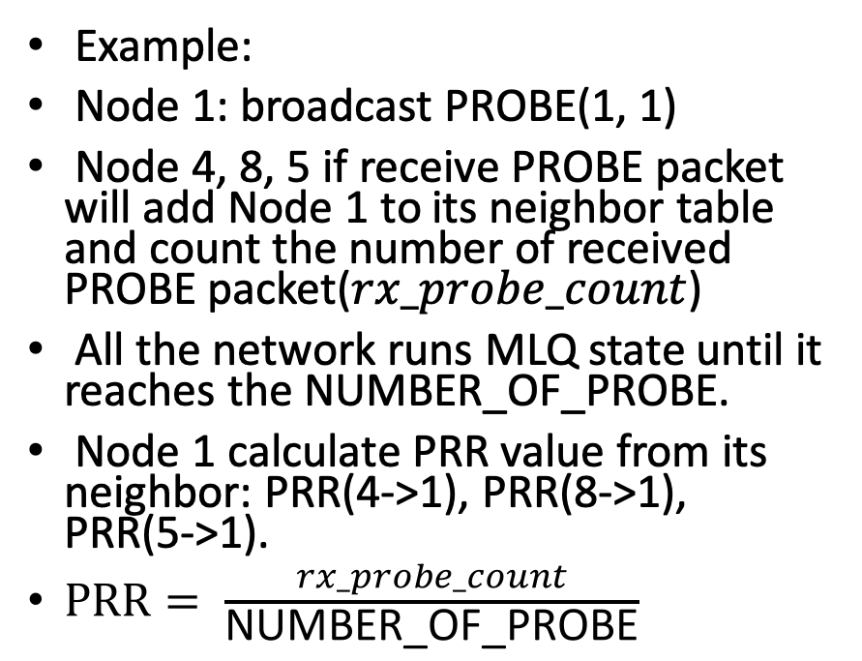
Measure Link Quality state
Example:
Node 1: broadcast PROBE(1, 1)
Node 4, 8, 5 if receive PROBE packet will add Node 1 to its neighbor table and count the number of received PROBE packet($rx_probe_count$)
All the network runs MLQ state until it reaches the NUMBER_OF_PROBE.
Node 1 calculate PRR value from its neighbor: PRR(4->1), PRR(8->1), PRR(5->1).
$PRR= \frac{rx_probe_count}{\text{NUMBER}\text{_}\text{OF}\text{_}\text{PROBE}}$
1
4
8
5
6
7
3
2
Fig. 3: Example network in MLQ state.

Slide 12
Measure Link Quality state
After calculate PRR for each neighbor, Node will send PRR value for each neighbor by unicast using Orchestra slotframe.
Each node will remain 2 PRRs value:
Forward_PRR(Node->Neighbor)
Backward_PRR(Neighbor->Node)
1
4
8
5
6
7
3
2
Fig. 3: Example network in MLQ state.

Slide 13
Make Routing state
In Make Routing state, Coordinator will send BUILDING_TREE_INIT message contain ist Rank (init = 0) to lower level node.
PROCESS(cnlab_send_building_tree_init_process, "send BT INIT process");
1
Level 0
4
16
32
16
8
5
Level 1
16
16
6
16
7
3
Level 2
32
2
Level 3
Fig. 5: Example network in Make Routing state.

Slide 14
Make Routing state
Node received will calculate Rank:
Rank = neighbor_rank*forward_prr;
After calculate Rank, each node broadcast BUILDING_TREE_COMPARE contains its Rank to the neighbor.
PROCESS(cnlab_send_building_tree_compare_process, "send BT COMPARE process");
1
Level 0
4
16
32
16
8
5
Level 1
16
16
6
16
7
3
Level 2
32
2
Level 3
Fig. 5: Example network in Make Routing state.

Slide 15
Make Routing state
Each node choose the lowest Rank received from BUILDING_TREE_COMPARE to determine the parent node, then send unicast BUILDING_TREE_RESPONSE to its parent.
static void cnlab_route_response_output(linkaddr_t *lladdr)
1
Level 0
4
16
32
16
8
5
Level 1
16
16
6
16
7
3
Level 2
32
2
Level 3
Fig. 5: Example network in Make Routing state.

Slide 16
Make Routing state
After choose parent node, Each node start Routing to lower level by broadcasting BUILDING_TREE_INIT as Coordinator progress.
1
Level 0
4
16
32
16
8
5
Level 1
16
16
6
16
7
3
Level 2
32
2
Level 3
Fig. 5: Example network in Make Routing state.

Slide 17
Collect Node Information state
All sensor nodes send a Node Information packet to its parent node until it reaches the Coordinator.
If the parent is not the Coordinator, it will forward the packet to next hop.
Node Information packet contains: (Node ID, Parent ID, Number Child, Child List[ ], Data Period)
Orchestra unicast slotframe
PROCESS(cnlab_send_node_information_process, "send Node Information process");
1
4
16
32
16
8
5
16
16
6
16
7
3
32
2
Fig. 6: Example network in Collect Node Information state.

Slide 18
Make Schedule state
After the Coordinator collects all the Node Information to make a schedule for Data transmission.
The Coordinator will send those data to the Scheduling Server(Raspberry Pi) through UART.
PROCESS(cnlab_run_pcllf_schedule, "run PCLLF schedule");
1
Scheduling Server
4
16
32
16
8
5
16
16
6
16
7
3
32
2
Fig. 7: Example network in Make Schedule state.

Slide 19
Make Schedule state
Scheduling Server runs Path Conflict-free Least Laxity First Algorithm (PCLLF) or New Scheduling Algorithm use Queue Level to make schedule and Send back to the Coordinator.
Scheduling Algorithm implemented in Rasberry Pi
1
Scheduling Server
4
16
32
16
8
5
16
16
6
16
7
3
32
2
Fig. 7: Example network in Make Schedule state.

Slide 20
Make Schedule state
Coordinator Node will download the Scheduling Information by Unicast Path Finding Algorithm.
Scheduling Sever will process packet contain Schedule for each Path.
Unicast Path Finding Algorithm implemented in Rasberry Pi
1
Scheduling Server
4
16
32
16
8
5
16
16
6
16
7
3
32
2
Fig. 7: Example network in Make Schedule state.

Slide 21
Make Schedule state
Example:
Path: 1->4->6->2
Packet format:
[Path size, Frag_index, Number of Fragments][LCM][Path Data][Sender, Receiver, Number of Transmission][(ts, ch); (ts, ch); …]
Link 1->4
[2, 0, 0][32][1,4][4, 1, 2][(0, 0);(1, 0)]
1
Scheduling Server
4
16
32
16
8
5
16
16
6
16
7
3
32
2
Fig. 7: Example network in Make Schedule state.

Slide 22
Make Schedule state
After receive Schedule data, All sensor node update schedule data by remove Orchestra slot frame and Update PCLLF schedule.
static voidcnlab_make_schedule_timer_callback(void *ptr)
1
Scheduling Server
4
16
32
16
8
5
16
16
6
16
7
3
32
2
Fig. 7: Example network in Make Schedule state.

Slide 23
Data Transmission state
After all nodes download schedule information. It will run data transmission base on the schedule.
PROCESS(cnlab_send_data_process, "send Data Packet");

